Slide 1

OUR BEST FRIEND

Slide 2



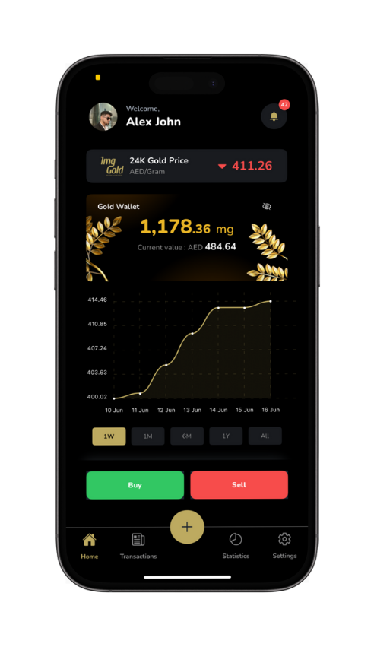

Buy
Sell
Instantly buy pure gold anytime at live market rates with just a tap.
Securely sell your gold holdings and withdraw cash to your bank account.
Redeem your digital gold for physical delivery right to your doorstep.
Gift
Gift gold instantly to friends and family with zero transfer fees.
Redeem
support@royalbullioncapital.com
www.1mg.gold |
www.royalbullioncapital.com

Slide 3
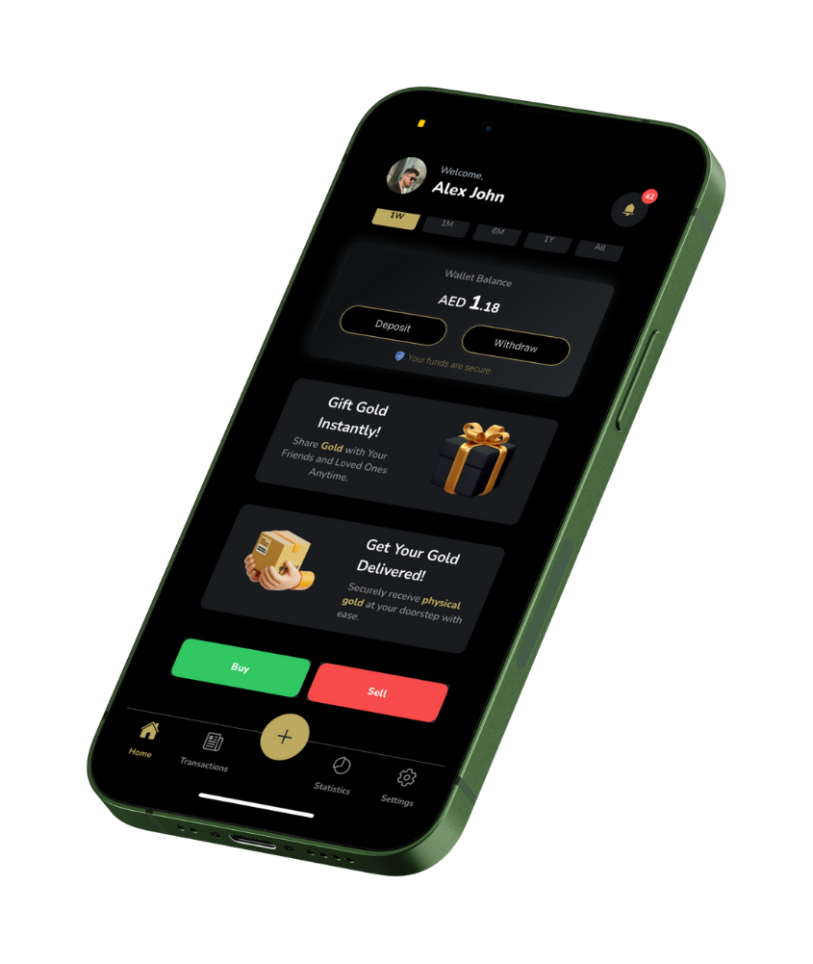
The 1mg.gold platform is designed to align with Shariah-compliant principles, making it an attractive option for investors who wish to adhere to Islamic banking laws. Here's how it's connected:
support@royalbullioncapital.com
www.1mg.gold |
www.royalbullioncapital.com

Slide 4
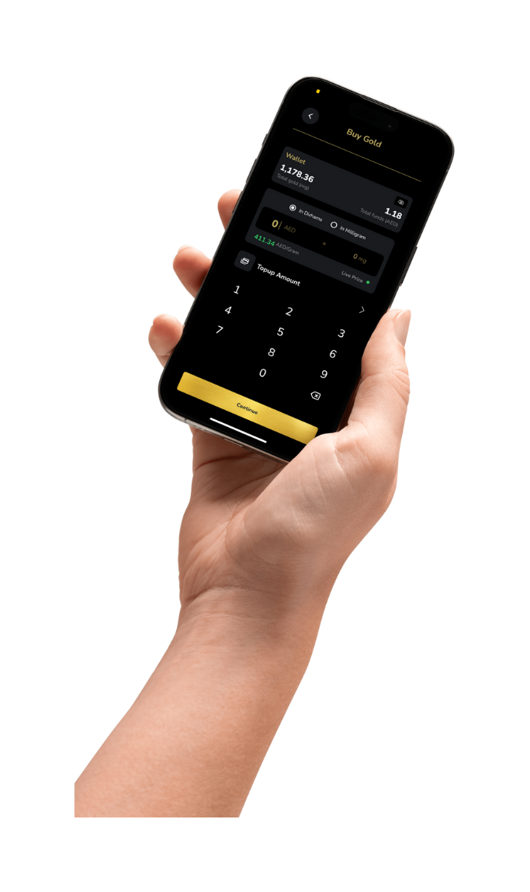
SHARIAH COMPLIANCE
    Asset-Backed Investment (No Riba) – Backed gram by gram by actual gold store securely
    No Speculation (Gharar) – Transparent Pricing & Value
    Halal Trade (Bai al-Sarf) – Purchase is immediate and Fair- buy it its yours – Real Time ownership
    Zakat-Eligible Asset –Hold it for one year – Above Nisab threshold.
    Ethical Use of Funds focuses purely on gold — a universally accepted halal asset.
1Mg.Gold
support@royalbullioncapital.com
www.1mg.gold |
www.royalbullioncapital.com

Slide 5
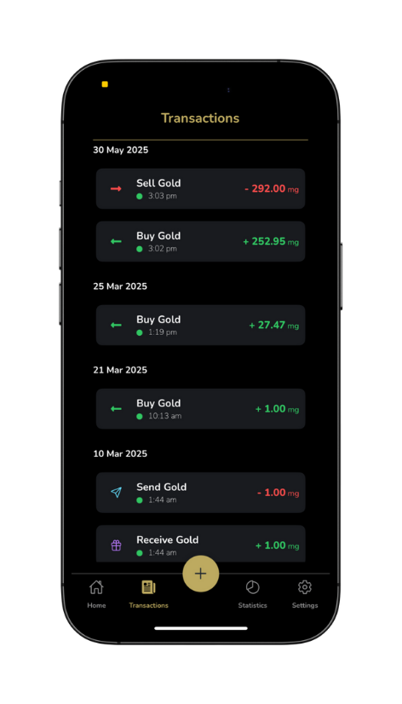
Lets Summarise
Why It's Shariah-Compatible
    ✔️ Gold-backed (tangible)
    ✔️ Transparent and fair pricing
    ✔️ No interest or speculation
    ✔️ Real-time ownership
    ✔️ Supports Islamic financial ethics
    We follow the Shariah Banking laws as Shariah provides very specific guidelines for gold trading and tokenization, and platforms like 1MG.gold can align with those principles if structured properly.
support@royalbullioncapital.com
www.1mg.gold |
www.royalbullioncapital.com

Slide 6
THANK YOU
support@royalbullioncapital.com
www.1mg.gold |
www.royalbullioncapital.com

